Slide 1
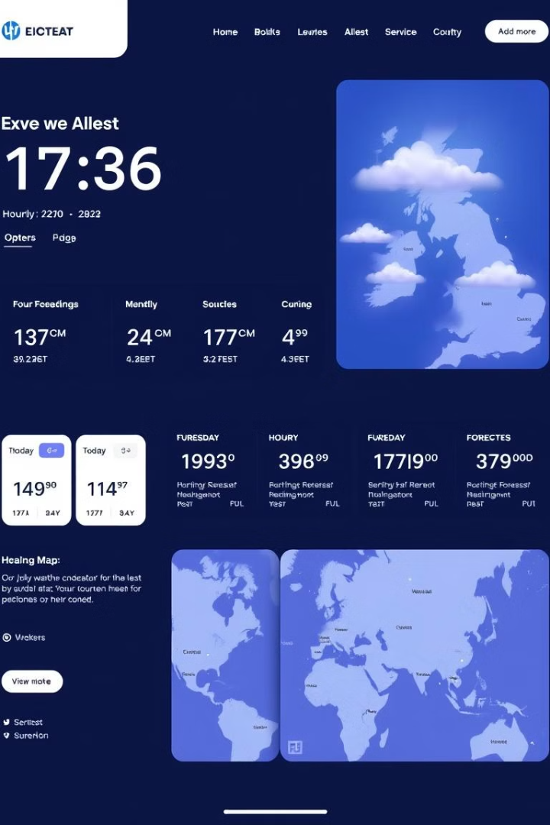
Weather Website Internship Project
This presentation showcases the development of a weather information website, highlighting its key features, design, and functionalities.

Slide 2

Introduction and Goals
1
Weather Information
2
User-Friendly Interface
3
Interactive Experience
Provide accurate and up-to-date weather data.
Easy to navigate and access information.
Engage users with interactive maps and animations.

Slide 3
Technologies Used
Front-End
Back-End
APIs
HTML, CSS, JavaScript.
Python, Flask, SQL Database.
OpenWeatherMap API for weather data.

Slide 4

Features and User Interface
Current Weather
Hourly Forecast
Real-time temperature, humidity, wind, and precipitation.
Detailed weather predictions for the next 24 hours.
Daily Forecast
Interactive Maps
Weather summary for the next 7 days.
Visualize weather conditions and forecast across regions.

Slide 5
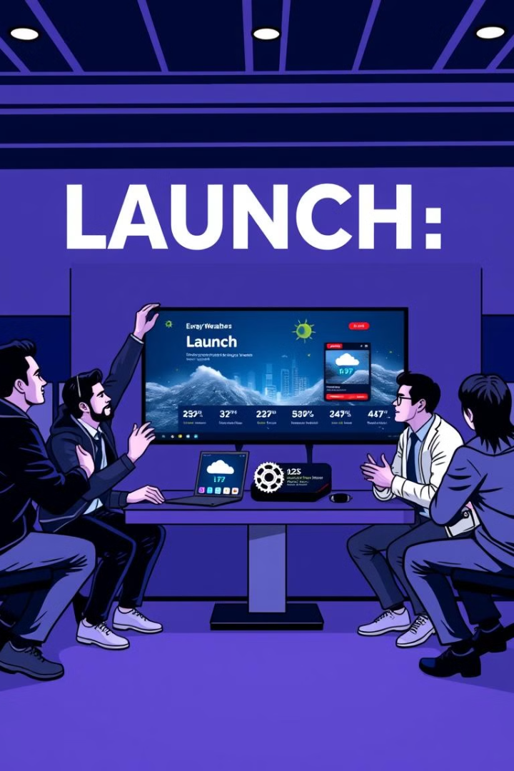



Next Steps and Conclusion
Future Enhancements
Add more features and functionalities.
User Feedback
Collect feedback for further development.
Project Completion
Successfully developed a functional weather website.

